Slide 1
Salesforce Experience Cloud
(Community Cloud)

Slide 2
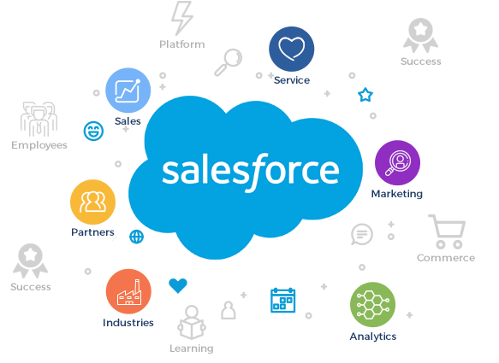
Overview
Communities are a great way to share information and collaboration with people who are key to business, such as customers, partners, or employees.
Salesforce Community Cloud is a platform that enables organizations to build and manage online communities.
Renamed as “Experience cloud”.
Experience Cloud is a set of tools and services that help companies deliver personalized and consistent customer experiences across various channels, such as websites, mobile apps, and social media.
It enables companies to plan, execute, and analyze customer engagement strategies.
With Experience Cloud, any organization can build digital experiences by using no-code, low-code, and pro-code tools.

Slide 3
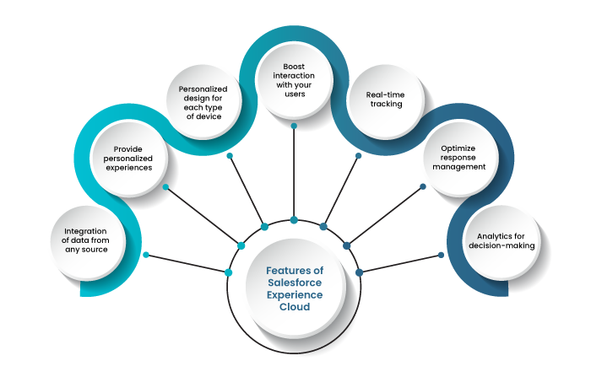
Key Features
Integration of data from any source: With Experience Cloud, data can be integrated from any source, including leads, prospects, cases, campaigns, orders, financial reports, and custom objects.
Provide personalized experiences: create tailored experiences in accordance with the expectations of each type of user. Salesforce Experience Cloud does this by leveraging CRM data to accomplish appropriate segmentation of target markets, audiences, and users.
Personalized design for each type of device: optimize the digital experiences that your business provides with various fully functional templates for all types of mobile devices, with an easy and intuitive interface.
Boost interaction with users: manage personalized badges to reward the most active users in your community.
Real-time tracking: Provides the ability to measure, process, and analyze data using customizable Lightning dashboards in Experience Workspace.
With Experience Cloud, you can build various brand spaces adjusted to the corporate style and business flows.

Slide 4
Key Features(Continued)
Optimize response management: group together the brand information available through all the pages and experiences generated.
Analytics for decision-making: For certain users, reports and dashboards can be presented.

Slide 5
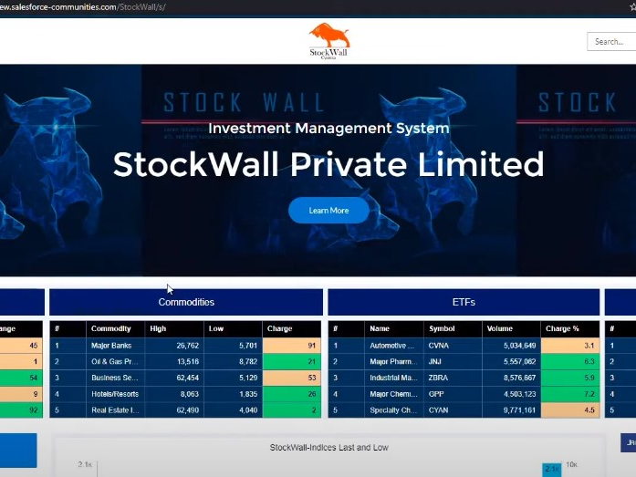
Use Case – Stock exchange site
A stock exchange community was built using the experience cloud, this can be accessed across multiple devices.
Users can log in and check all the major indices across all the platforms.
Users can customize charts and reports.
The site has already been connected with similar communities for data exchange.

Slide 6
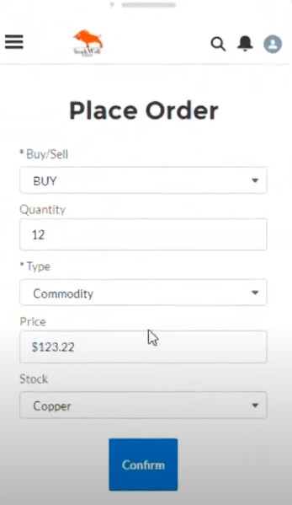
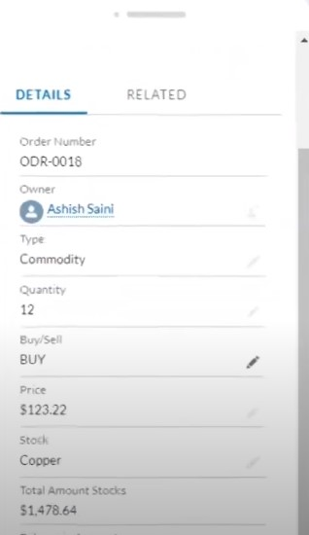
Challenges
To create a stock market community which works across all platforms.
To create an all-in-one marketplace where user can get real-time stock quotes and market data.
To enable Trading tools and platforms for buying and selling stock.
Solutions
Community cloud helps to build a platform independent sites.
Users can receive real-time updates through the integration of all salesforce applications.
Users can trade easily by proving all required values and clicking on confirm.

Slide 7

Challenges
To Provide educational resources and market analysis.
To provide a forum to discuss and analyze stocks with other users.
Solutions
Community Cloud enables sharing of resources across other communities.
Users can join discussion forums or follow other investors to share ideas and insights.

Slide 8
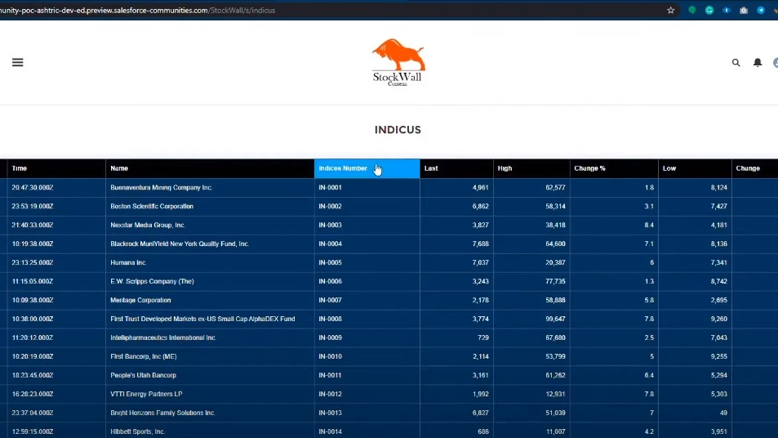
Challenges
To manage investments.
To enable users to conduct research.
Solutions
Users can track the performance of their portfolio, set up alerts for price changes or other events, and review their trading history.
Users can access financial data and analysis tools to help them make informed investment decisions through external resources.

Slide 9
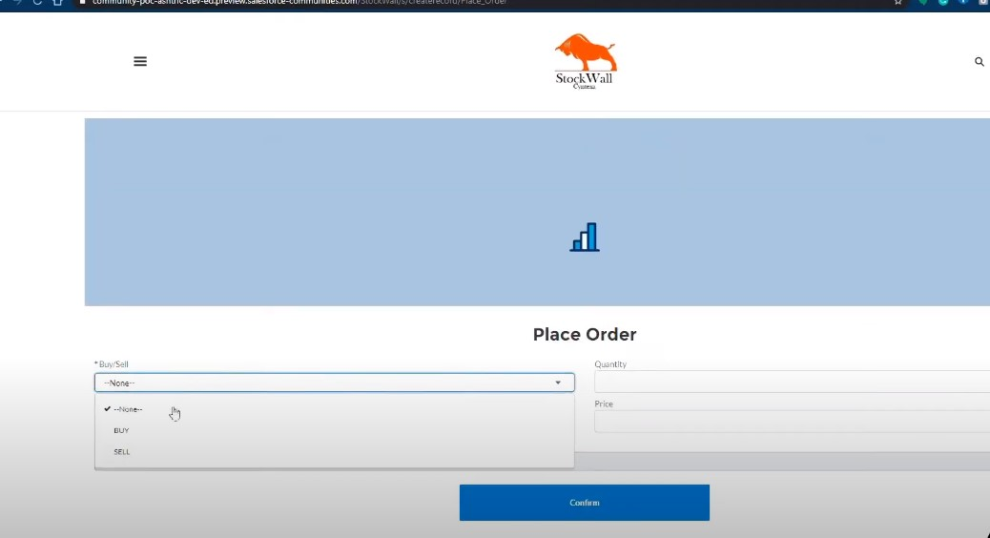
Challenges
To promote the community and encourage participation.
Solutions
Users can use Salesforce's marketing and engagement tools to reach out to potential members and encourage them to join and participate in your community.

